Slide 1
Different Types 2

Slide 3

Internet is a web of connections. There are different types of connection that provide internet connectivity to the user
Notes:
An interconnected web is an internet. The user can connect to the internet using a variety of connection types.

Slide 4

Understand the different connection types in the internet
Understand ISDN and DSL Broadband in the internet
Understand satellite connection and fibre optics connection
Notes:
After the conclusion of this topic, you will be able to:
Describe the various internet connection types.
clearly recognize ISDN and DSL Internet Broadband.
understanding about fiber optic and satellite connections

Slide 5




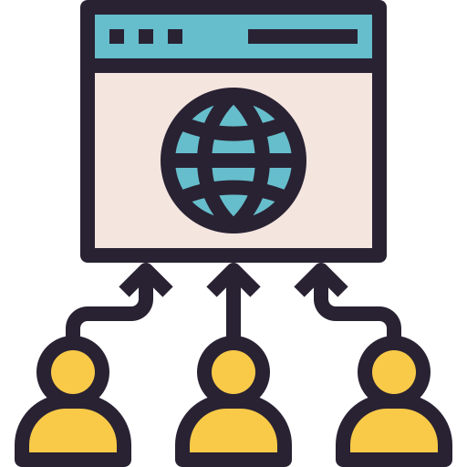
Factors in Choosing an ISP
Bandwidth
Connection availability
Virtual hosting feature
Stability and staying power
Customer volume and traffic
Notes:
Let us know that the Internet Service Provider is a specialised company that connects customers with personal computers and browsers to internet connectivity.
The factors for choosing an ISP are,
Bandwidth: Bandwidth refers to the maximum amount of data that can be transmitted over a network connection within a given time period. In the context of web hosting, bandwidth is a measure of how much traffic a website can handle without experiencing slow loading times or downtime.
connection availability: Connection availability refers to the reliability and uptime of a web hosting provider's network connection. A reliable connection ensures that your website is always accessible to visitors and that they can access it quickly without experiencing any interruptions or delays. When choosing a web hosting provider, it's important to look for one that has a high uptime guarantee and a proven track record of reliable service.
virtual hosting feature: This is an efficient way to host multiple websites without having to purchase and maintain separate servers for each site. Virtual hosting typically includes features such as email hosting, domain management, and database support, making it a cost-effective and convenient option for small businesses and individuals.
stability and staying power: A stable hosting platform ensures that your website will remain online and accessible to visitors, even during times of high traffic or server load. Staying power refers to the ability of a web hosting provider to remain in business for the long term. A provider with a strong track record and a proven commitment to customer service is more likely to provide reliable and stable hosting services over the long term.
customer traffic and volume: Customer traffic and volume are important considerations when choosing a web hosting plan. If your website receives a high volume of traffic, you'll need a hosting plan that can handle the increased load without experiencing slow loading times or downtime. Similarly, if your website includes large multimedia files or other content that requires a lot of storage space, you'll need a hosting plan with sufficient disk space and bandwidth to accommodate your needs.

Slide 6

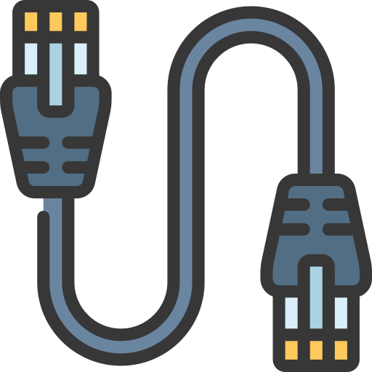
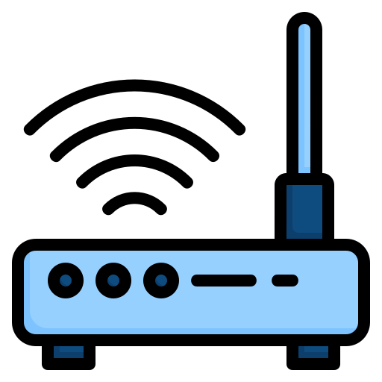
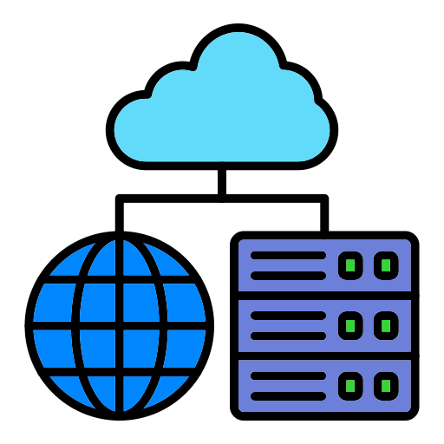
Types of Internet Connections
Internet Connection
Dialup or Analogue
Cable connection
DSL Broadband
ISDN
Notes:
Here are the types of internet connections.,
Dialup or Analogue : Dial-up or Analog is the oldest and the slowest form of internet connection. It uses a standard telephone line to establish a connection between your computer and the internet service provider (ISP). With a dial-up connection, you need to physically dial the ISP's number using a modem and then wait for the connection to be established. The speed of this connection is limited to a maximum of 56 Kbps, which is significantly slower than other forms of internet connection available today.
Cable connection : Cable internet connection is a form of broadband internet that uses the same coaxial cable that is used to transmit cable TV signals. The connection is established by plugging a cable modem into your computer. Cable internet provides faster speeds than dial-up and is more reliable.
DSL Broadband : Digital Subscriber Line (DSL) broadband is a high-speed internet connection that uses telephone lines to transmit data. DSL internet works by using a separate frequency range for data transmission, which allows it to provide faster speeds than traditional dial-up. The speed of DSL broadband can range from 128 Kbps to 100 Mbps, depending on the plan you choose.
ISDN : Integrated Services Digital Network (ISDN) is a type of digital telephone service that provides faster data transmission speeds than traditional analog phone lines. ISDN uses a digital signal that is sent over copper wire, allowing it to provide faster speeds than analog connections. The maximum speed of an ISDN connection is 128 Kbps. ISDN is less common than other types of internet connections and is typically used in business settings.

Slide 7


Dialup Connection
Dialup Connection
It is present nearly everywhere in the country due to low costing
The dial up connection aids connectivity to the internet through a dial up terminal connection
Notes:
Let us understand what Dial up connection,
Because it is so inexpensive, it is found almost everywhere in the nation.
Using a dial-up terminal connection, the dial-up connection facilitates connectivity to the internet.
Dial-up connection is a type of internet connection that was widely used before the advent of broadband internet. It uses the public switched telephone network (PSTN) to establish a connection between the user's computer and the internet service provider (ISP). The term "dial-up" refers to the process of dialing a phone number to connect to the ISP.
the user needs a modem, which is a device that converts digital signals from the computer into analog signals that can be transmitted over the telephone line. The modem also converts analog signals from the telephone line into digital signals that can be understood by the computer.
The modem then dials the phone number and establishes a connection with the ISP's modem.
One of the disadvantages of a dial-up connection is its slow speed. The maximum speed of a dial-up connection is 56 kilobits per second (kbps), which is much slower than the broadband speeds offered by cable, DSL, and fiber-optic connections.
dial-up connections are still used in some areas where broadband internet is not available or too expensive. They are also sometimes used as a backup option in case of a broadband outage.

Slide 8



ISDN
The Integrated Service Digital Network is abbreviated as ISDN
ISDN is a dial up service that has been used by telephone companies for several years
ISDN is not available everywhere due to high costs
Notes:
Let us understand about ISDN,
ISDN stands for Integrated Service Digital Network.
Telephone companies have been using ISDN, a dial-up service, for many years.
Due to its high price, ISDN is not offered everywhere.
It was introduced in the 1980s and was initially designed to replace the traditional analog telephone network. ISDN provides faster and more reliable data transmission than analog networks and allows for a more efficient use of the telephone network.
This means that a dedicated circuit is established between the two endpoints for the duration of the transmission. This is different from packet-switched networks, which are used for transmitting data over the internet.
ISDN is divided into two types of channels: B (bearer) channels and D (data) channels. The B channels are used for voice or data transmission, and each channel has a bandwidth of 64 kbps. The D channels are used for signaling and control purposes, and they have a bandwidth of 16 kbps. ISDN can support up to 30 B channels on a single line, which means that it can provide a total bandwidth of 1.92 Mbps.
It has also been used for internet access, although it has been largely replaced by broadband technologies such as DSL and cable modems.
ISDN has been widely used for business applications and internet access, although it has been largely replaced by broadband technologies.

Slide 9

DSL Broadband
The Digital Subscriber Line (DSL) is a group of technologies that aids fast internet using the telephone network
DSL Connection
ADSL
VDSL
SDSL
Notes:
Let us understand about DSL Broad band
DSL stands for Digital Subscriber Line. A DSL connection is a type of internet connection that uses existing copper telephone lines to transmit data. DSL technology uses high-frequency signals to transmit data over the telephone lines, while allowing voice traffic to continue on the same line. the speed and reliability of a DSL connection can depend on factors such as the distance from the nearest telephone exchange, the quality of the telephone lines, and the provider's network infrastructure.
There are three types of Digital Subscriber Line connection that are used in telecommunication marketing.
ADSL : ADSL stands for asymmetric digital subscriber line. It is the most widely used DSL technology and is often used for home internet connections. ADSL provides faster download speeds than upload speeds, hence the term "asymmetric". This is because most people download more data than they upload. ADSL works by using different frequencies for upstream and downstream data, which allows for simultaneous use of the phone line and internet connection.
VDSL : VDSL stands for very high-speed digital subscriber line. It provides faster download and upload speeds than ADSL and is suitable for businesses and homes with higher data usage requirements. VDSL uses a different modulation technique than ADSL, which allows for faster data transfer rates. However, VDSL has a shorter range than ADSL, meaning that it's not always available in all areas.
SDSL : SDSL stands for symmetric digital subscriber line. It provides equal upload and download speeds, making it suitable for businesses that need to send large files, such as videos or images. SDSL uses the same frequency for both upstream and downstream data, which eliminates the need for a splitter. SDSL is more expensive than ADSL and VDSL because it provides faster and more reliable data transfer rates.

Slide 10

Cable Modem Connection
A cable modem is a type of network bridge and modem that facilitates a broadband internet connection
The cable modem’s connection take advantage of the high bandwidth of an HFC and RFoG network
Notes:
Let us know that the cable modem works by using television channel space for data transmission.
A network bridge and modem that enables a broadband internet connection is known as a cable modem.
An HFC and R-Fog network's high bandwidth is used by the cable modem connection.
A cable modem connection is a type of internet connection that uses a cable television network to transmit data between a user's device and the internet. This type of connection is popular because it is generally faster and more reliable than other types of connections, such as dial-up or DSL.
The cable modem connects to the user's device, typically a computer or router, via an Ethernet cable.
One of the benefits of a cable modem connection is its speed. Cable modem connections can offer download speeds of up to 1 Gaps, which is much faster than other types of connections. This high speed is possible because cable television networks have a large amount of available bandwidth, which can be used to transmit data quickly.
This means that cable modem connections are less likely to be affected by factors such as distance from the network or the presence of other devices that may cause interference.

Slide 11


Satellite Connection
Satellite technology is a method by which the outgoing and incoming data are sent and received by a computer through a satellite
This connection is very sensitive to a rainy weather as it degrades the satellite signal
Notes:
Let us know about satellite connection.
Satellite connections use orbiting satellites to provide internet connectivity to users. This type of connection is ideal for areas that are remote or difficult to reach by traditional terrestrial connections such as fiber optic cables or DSL lines. Satellite internet technology has been around for several decades and has evolved to offer faster speeds and more reliable connections.
To access satellite internet, users need to have a satellite dish installed on their property that can receive signals from the orbiting satellites.
Satellite technology is a technique that allows a computer to send and receive data through a satellite.
Rainy weather has a significant impact on this connection because it weakens the satellite signal.
One of the main benefits of satellite internet is its wide coverage area. Because it uses satellites in orbit to transmit data, it can provide connectivity to areas that are not accessible by other types of internet connections.
satellite internet also has some limitations. One of the biggest drawbacks is latency, which refers to the time it takes for data to travel from the user to the satellite and back to the user. This latency can cause delays and lag, which can make some online activities such as online gaming or video conferencing difficult or impossible.

Slide 12
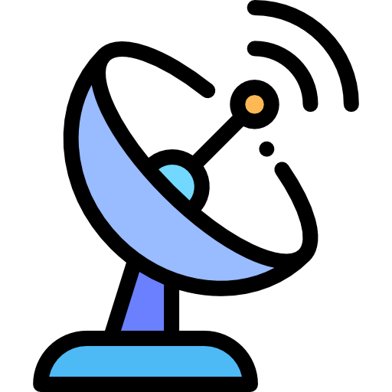
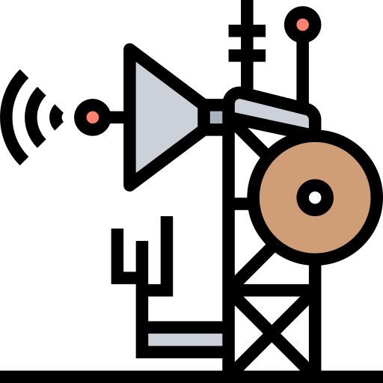
VSAT
The Very Small Aperture Terminal is abbreviated as VSAT and it is used in satellite communication
The satellite senses and receives signals from a ground station computer that acts as the hub for the system
Notes:
Let us know about VSAT.
VSAT, or Very Small Aperture Terminal, is a type of satellite communication system that is used to provide internet connectivity, data communication, and voice communication in remote or hard-to-reach areas. It works by transmitting and receiving data via a satellite that is orbiting the earth.
The VSAT system consists of three main components: the satellite, the hub station, and the VSAT terminal.
VSAT systems are commonly used in remote areas where terrestrial communication infrastructure is not available. They are widely used in industries such as oil and gas, mining, maritime, and aviation, where reliable communication is crucial for business operations. VSAT systems are also used in disaster management and relief operations where communication infrastructure may be destroyed or unavailable.
A Very Small Aperture Terminal contains two parts, a transceiver and a device that interfaces the transceiver with the end’s user communication device, such as a personal computer.
The VSAT senses and receives signals from a ground station computer that acts as the hub for the system.
The Very Small Aperture Terminal, or VSAT, is a satellite communication device.
A ground station computer serves as the system's hub and sends signals to the satellite, which detects and receives them.

Slide 13


Fibre Optic Connections
The fibre optic broadband is very easy to integrate with other features and systems
Fibre is one of the fastest optic connection that connects from the telephone exchange
Notes:
Let us know about the fibre optic connection that facilitates much faster connection.
Fiber optic connections are a type of telecommunication technology that uses light to transmit data over long distances. This technology has revolutionized the way we communicate, allowing us to send large amounts of data quickly and reliably. Unlike traditional copper-based cables, fiber optic cables are made of glass or plastic and use light to transmit data instead of electrical signals. This makes them immune to interference from other electrical devices, which can cause data loss or corruption.
Fiber optic connections have many advantages over traditional copper-based cables. First, they have a much higher bandwidth capacity, which means they can transmit more data at faster speeds.
Fiber optic connections are also more reliable than traditional cables because they are less prone to interference and can withstand harsh weather conditions.
It is quite simple to integrate fiber optic broadband with other features and systems.
One of the quickest optical connections available from the telephone exchange is fiber.

Slide 14


Disadvantages and Advantages of Fibre Optics
Fibre is expensive and disruptive to install.
The end user must have equipment and power source continually
The main advantage of fibre is the speed and reliability.
Fibre optic is basically more durable than copper
Notes:
Let us check the disadvantages and advantages of the fibre optic connection.
The drawbacks of Fiber optic are:
The Fiber optic is expensive and disruptive to install.
The end user must have equipment and power source.
The Advantages of Fiber optics are
The communication takes place very fast and it is very reliable.
The Fiber optic is more durable than copper.

Slide 15
The different Internet connection types
The Integrated Service Digital network is more commonly present in metropolitan areas
The fibre optic broadband is very easy to integrate with other features and systems
Notes:
In this topic, you discovered:
The various types of Internet connections.
Metropolitan areas are where the Integrated Service Digital network is more common.
It is quite simple to integrate fiber optic broadband with other features and systems.

